Slide 1
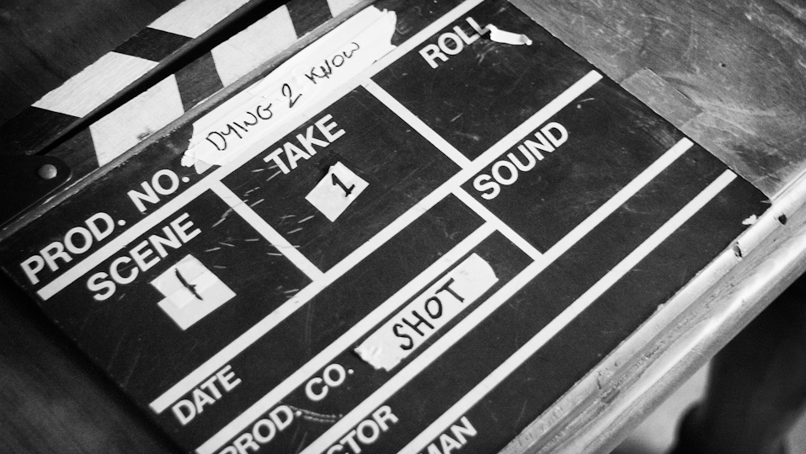
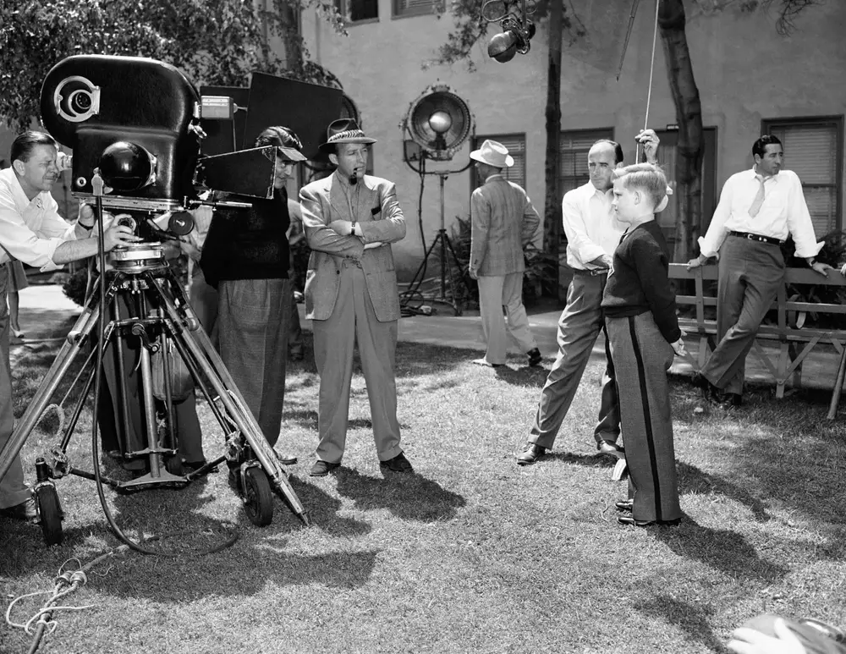
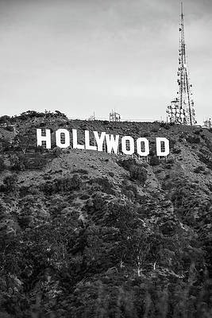
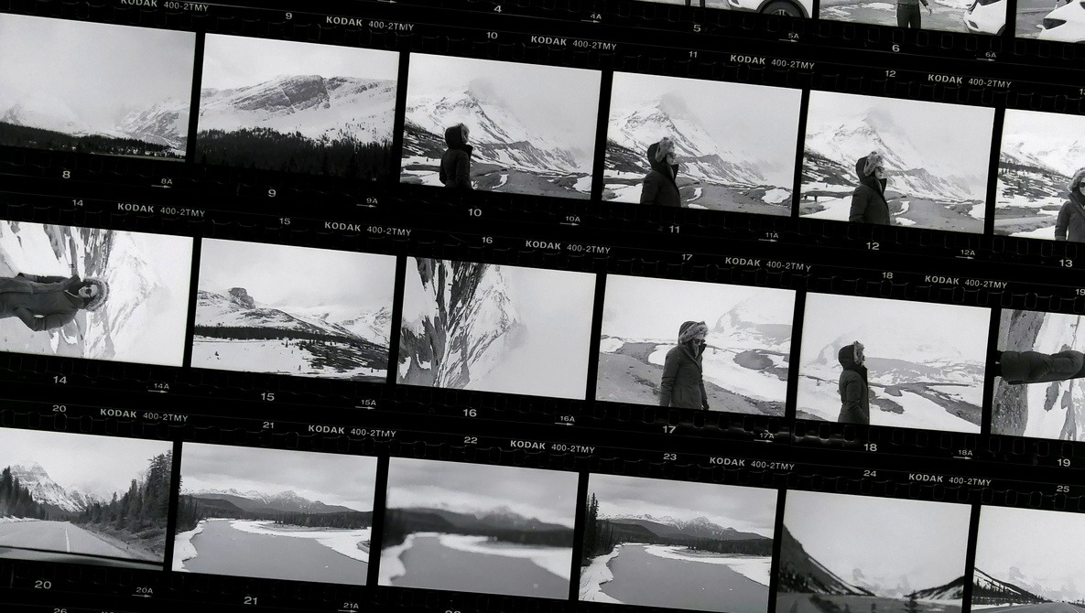
Analysis of the Film Industry

Slide 2
Background
How to pick a movie to watch? What types of movies should directors keep producing?
Has the film industry changed to reflect societal norms? Looking specifically from a gender and language perspective.
Understanding what predicts movie ratings and popularity over time and across genres is crucial for both filmmakers and viewers. It provides insights into evolving audience preferences, allowing filmmakers to make informed decisions in casting, directorial styles, and genre selection.
For viewers, this knowledge enhances the movie-watching experience, enabling informed choices based on historical data.
Gender-conscious casting provides insights into representation dynamics, influencing audience connection and challenging stereotypes. It contributes to societal impact by promoting inclusivity and reshaping cultural narratives.
Language analysis in taglines is equally crucial; it shapes marketing, audience expectations, and societal perceptions. Thoughtful language choices can break stereotypes and foster inclusivity. This scrutiny holds the industry accountable for diversity and aligns with market demands, enhancing a film's relevance and success.
Empowering filmmakers with insights into gender dynamics and language as well as impact facilitates informed decisions, fostering positive social change and creating content that resonates with diverse audiences. In essence, these analyses are strategic for industry competitiveness, cultural sensitivity, and societal progress.
Notes:
Michael

Slide 3
Project Outline
Numbers Based
Sentiment Based
What variables help predict movie ratings & popularity?
How does casting impact ratings and popularity? Has casting changed over time to represent a more inclusive society?
How do genres trends change over time with respect to rating and popularity scores?
genres over time?
How do the most popular words per genre change over time when looking at the tagline? Does this mirror societal change?
What are the most popular genres based on language of film?
Purpose: Facilitate informed decision-making for directors and movie enthusiasts in their selection of films for production or viewing. This initiative strives to provide valuable guidance by analyzing key factors that contribute to the appeal and relevance of movies. By offering insights into the qualities that resonate with audiences and align with contemporary preferences, it aims to empower filmmakers and viewers alike to make more discerning choices in the dynamic world of cinema.
Purpose: Explore the evolution of movies over time as reflective mirrors of societal changes. This analysis aims to provide valuable insights for both directors and movie enthusiasts, fostering a deeper understanding of thematic principles embedded in films. By delving into how society perceives and interprets certain themes through cinema, this endeavor seeks to unravel the intricate relationship between movies and societal perspectives.
Notes:
Kiran

Slide 4
Data Sources
Kaggle Movies Dataset (cast + crew + genders + movie metadata)
45,000 Data Points
Movie Scripts Corpus (scripts)
3,000 different movie scripts
Notes:
Maggie

Slide 5
Question 1: What variables help predict movie rating and popularity?

Slide 6
Question 1: Background
Aim to understand what can predict popularity value/high ratings based on multiple different factors
Methodology:
Multiple Linear Regression
Predicted Values
Correlation

Slide 7
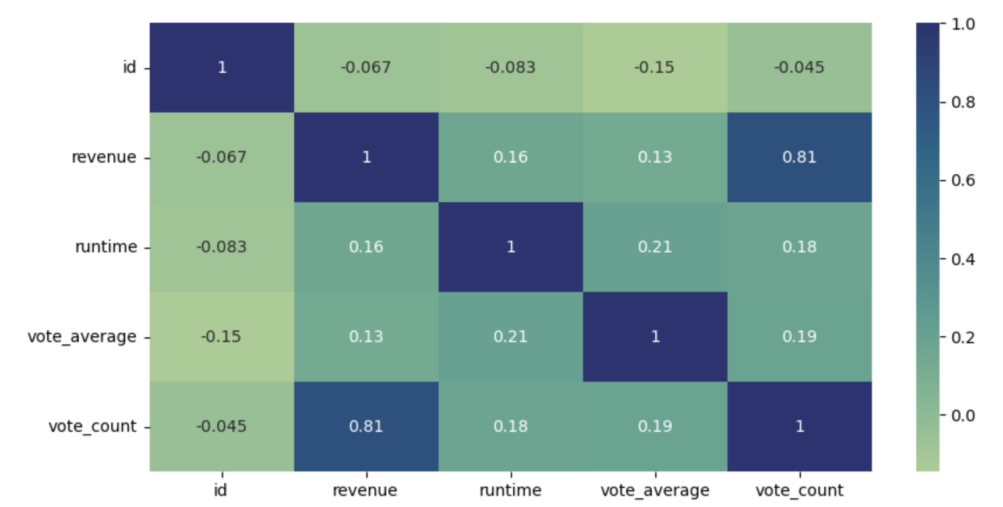
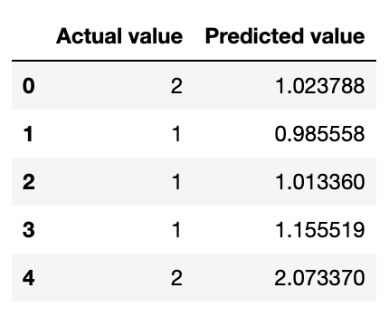
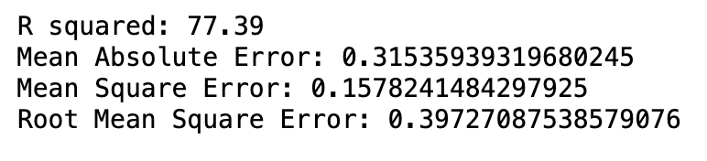
Question 1: Results - Popularity
Popularity= 1.37e⁻⁸ Budget + 1.19e⁻⁸ Revenue + 1.06e⁻² Run Time + .43 Vote Avg + 4.51e⁻³ Vote Count + .95

Slide 8
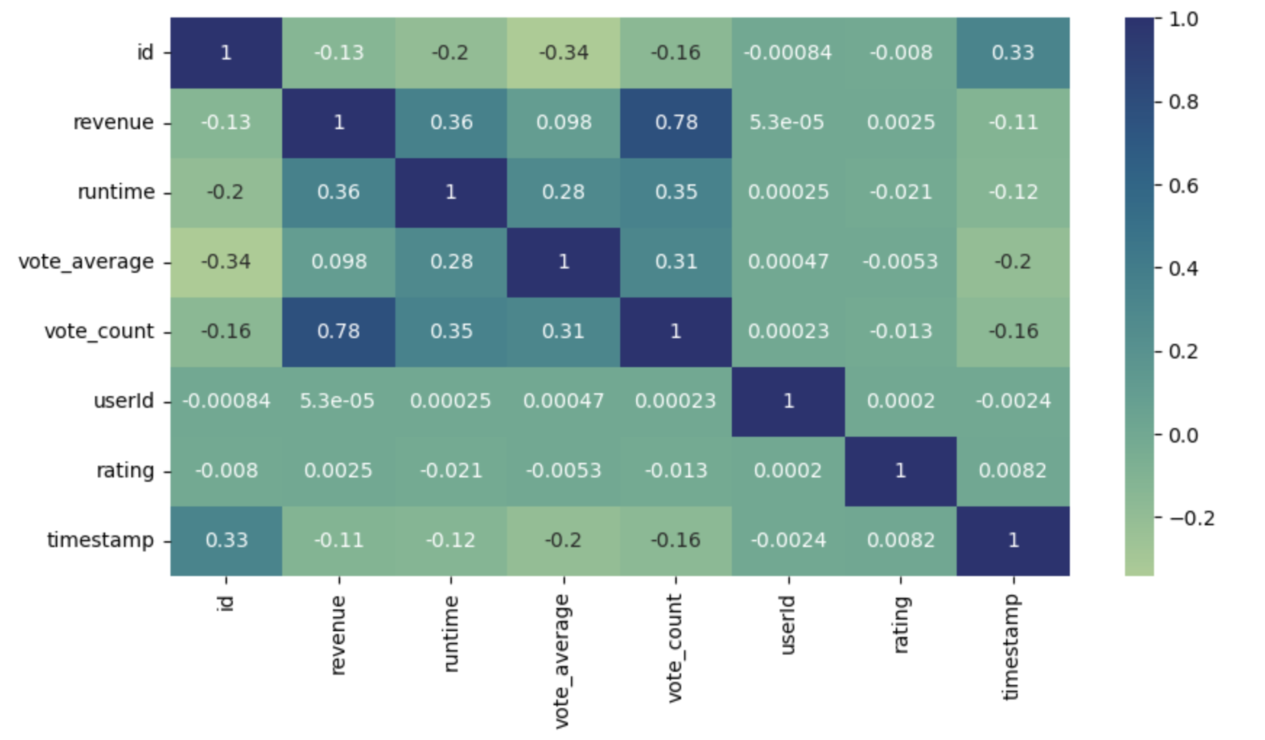
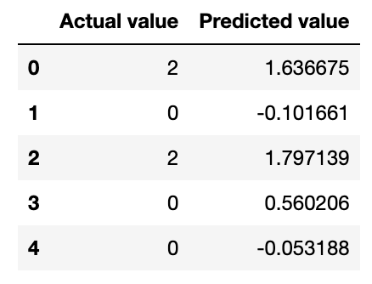
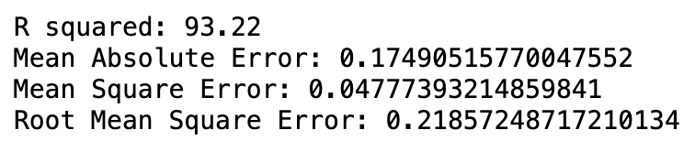
Question 1: Results - Rating
Rating= -1.62e-3 Vote Avg + -9.55e-6 Vote Count + 1.74

Slide 9
Question 2: How do genre trends change over time with respect to rating and popularity scores?

Slide 10
Question 2: Background
Aim to study what kind of genres people are interested in at a certain time frame and how it changes
Top 50 movies with highest scores are selected for each decade.
13 decades from 1890 to 2020
Movies are ranked based on average ratings and popularity (separately)
Ratings:
From 0 to 5 with 0.5 increments
Multiple ratings by different users per movie and average rating is calculated
Popularity score:
Calculated by IMDB based on votes, views, numbers marked as ‘favourite’, number added to “watchlist”

Slide 11
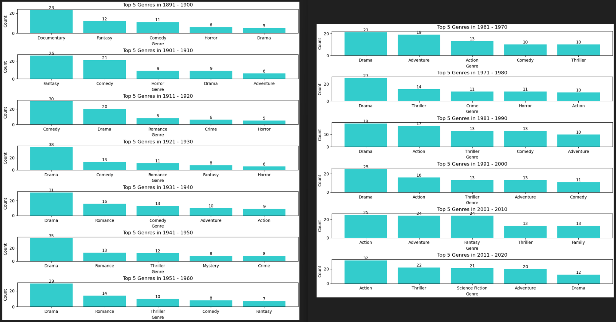
Question 2: Results - Popularity

Slide 12
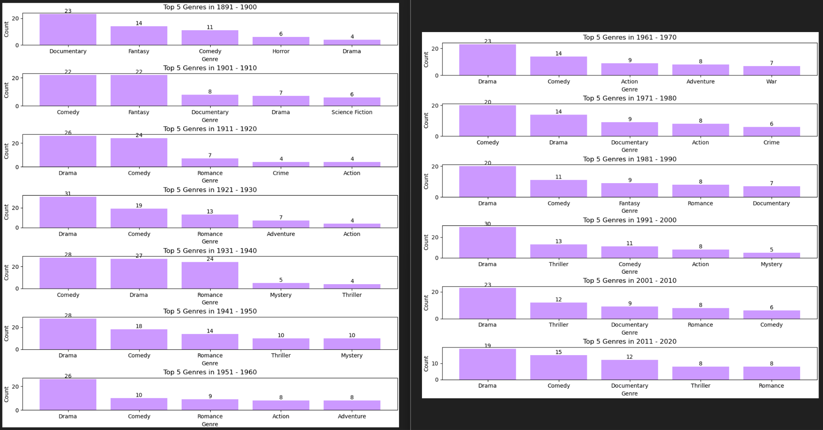
Question 2: Results - Rating

Slide 13
Question 3: What are the most popular genres based on language of film?

Slide 14
Question 3: Background
Exploring the most well-known movie genres according to language.
Curious about the top ten languages (out of 92 languages used) in terms of revenue.
To be aware of the "top genres" in those languages globally.

Slide 15
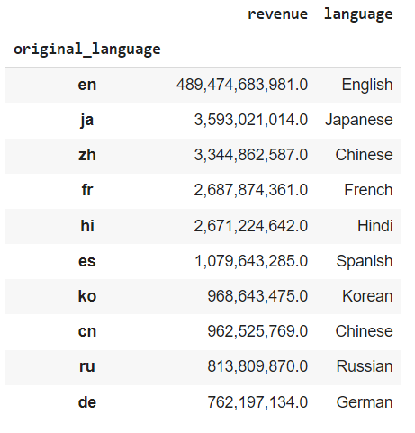
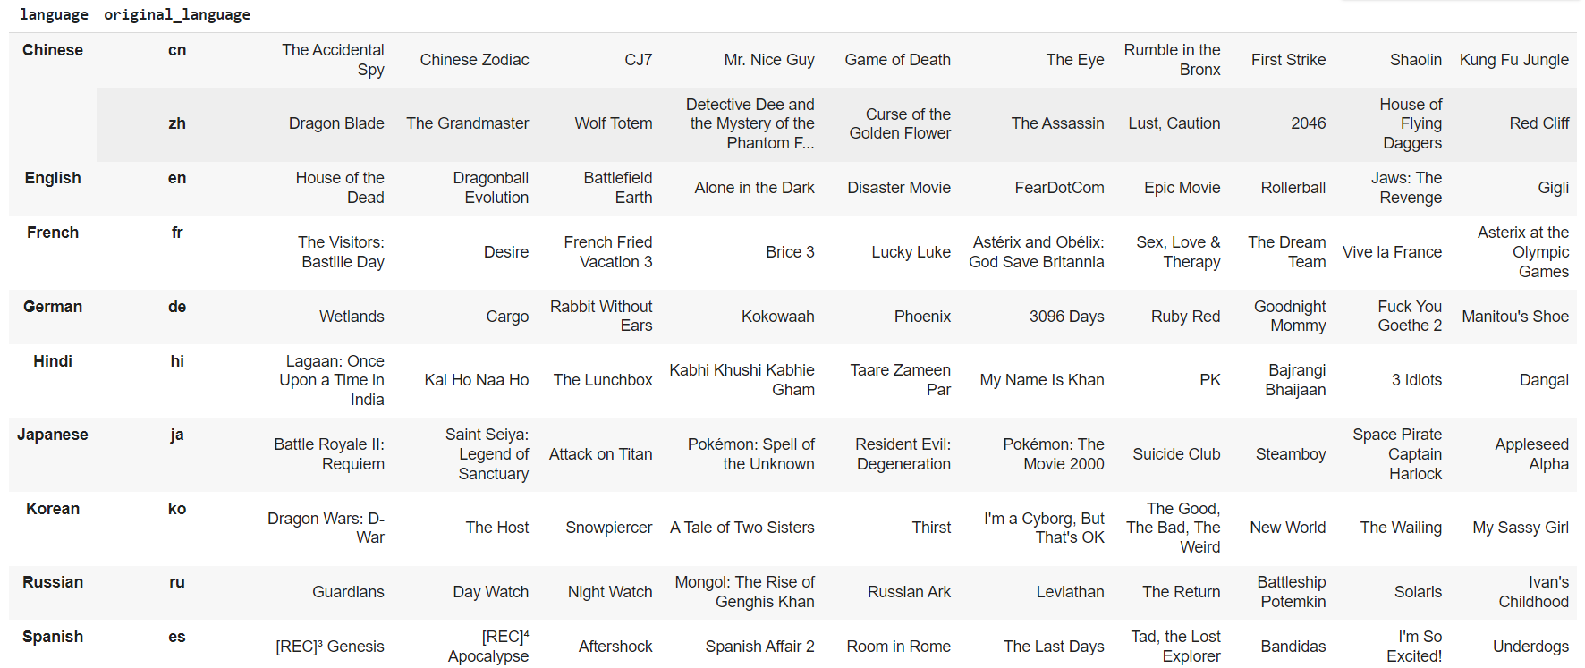
Question 3: Results

Slide 16
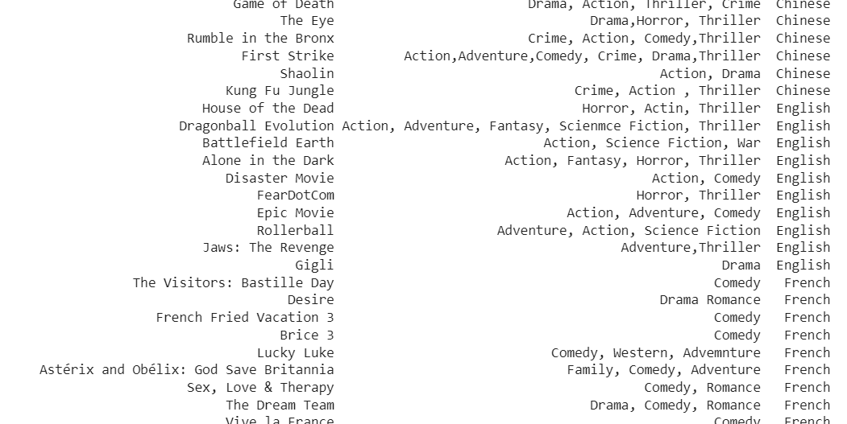
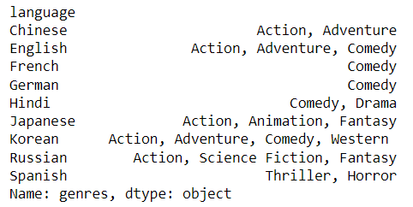
Question 3: Results

Slide 17
Question 4: How does casting impact ratings and popularity? Has casting changed over time to represent a more inclusive society?

Slide 18
Question 4: Background
Scripts: Nearly 3,000 Movie Scripts from the early 1900’s to 2021
List of words negatively associated with women (pulled from external sources)
Question: Has the prevalence of slurs and negative terminology toward women decreased at all?
Lists of Male, Female, & Neutral pronouns and descriptors
Question: What is the nature of scriptwriting in film from a gender standpoint, and has their focus shifted to become more inclusive?

Slide 19
Question 4: Results
 | Casting by Decade | Casting by Year | Casting by Production Company | Casting by Budget | Rating by Casting | Popularity by Casting | Negative Language towards Women over time | Female Centered Language over time | Negative Language towards women in comparison to casting | Female centered language in comparison to casting
P-value | .189 | .119 | .931 | .939 | .00572 | .00153 | .479 | .211 | .475 | .682
Not enough evidence to show Male to Female ratio has changed over time.
Not enough evidence to show Male to Female ratio changes by Production Company.
Not enough evidence to show Male to Female ratio changes by Budget.
There is enough evidence to show that the rating does change based on the male to female cast ratio.
There is enough evidence to show that the popularity does change based on the male to female cast ratio.
Not enough evidence to show that the negative words surrounding women within scripts has changed over time.
Not enough evidence to show that the female centered words within scripts has changed over time.
Not enough evidence to show that the negative words surrounding women changes throughout distinct male to female cast ratios.
Not enough evidence to show that the female centered words within scripts changes throughout distinct male to female cast ratios.

Slide 20
Question 5: How do the most popular words per genre change over time when looking at the tagline? Does this mirror societal change?

Slide 21
Question 5: Background
Tagline from 45,000+ movies
Count of most popular words
By Genre + Decade
Question: What are the most popular themes per genre? Are they changing over time to reflect societal norms/desires?
By Popularity
Question: What are the most popular words used in taglines based on popularity? What connotations to these words have?
By Vote Average
Question: What are the most popular words used in taglines based on rating? What connotations to these words have?

Slide 22
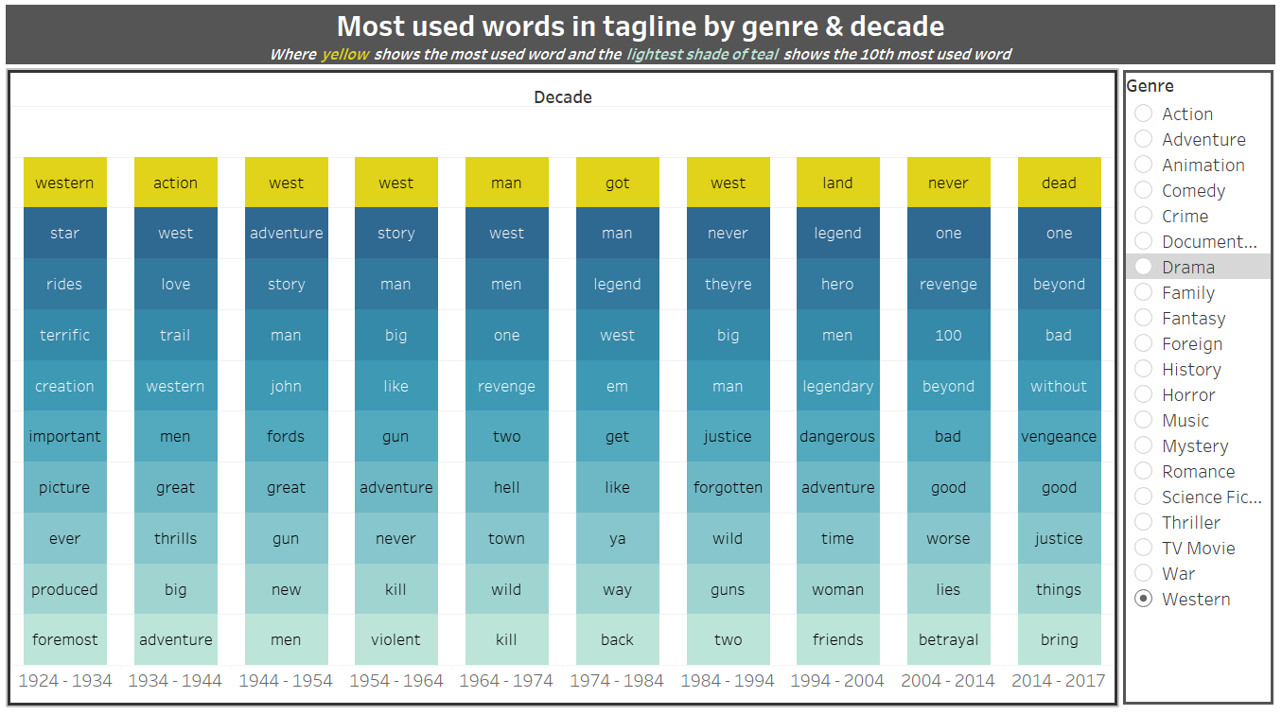
Question 5: Results - Genre & Decade (Western)
The 1924-1934 theme centers on the American West, combining expansive landscapes, human presence, and a blend of civilization and wilderness. The mention of "guns" suggests ruggedness, while "forgotten" implies neglect, and "two" hints at duality.
The 2014-2017 theme explores morality, justice, and consequences, with a focus on negativity, moral righteousness, and a transcendent aspect beyond the ordinary.
Click here to explore

Slide 23
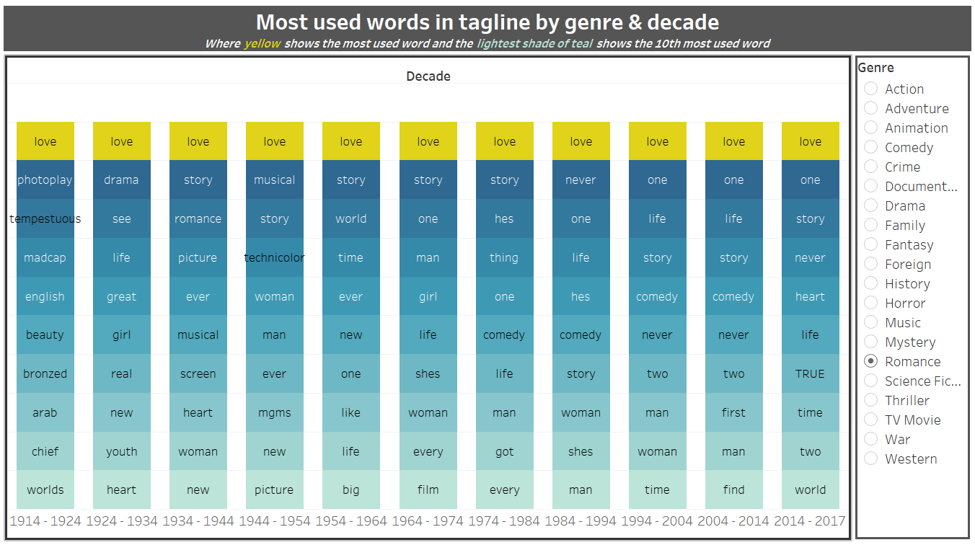
Question 5: Results - Genre & Decade (Romance)
1914-1924 theme revolves around what seems to be a foreign plot. It mentions words like “worlds”, “arab”, “bronzed” which references things from around the world. Throwing in words like English show that it could potentially be a plot about lovers from across the world.
2014-2017 theme also centers on love and relationships, emphasizing uniqueness with "one" and authenticity with "true." "Story" suggests a narrative or journey, "heart" adds an emotional dimension, and "world" expands the context. "Two" implies duality or partnership.
Click here to explore

Slide 24
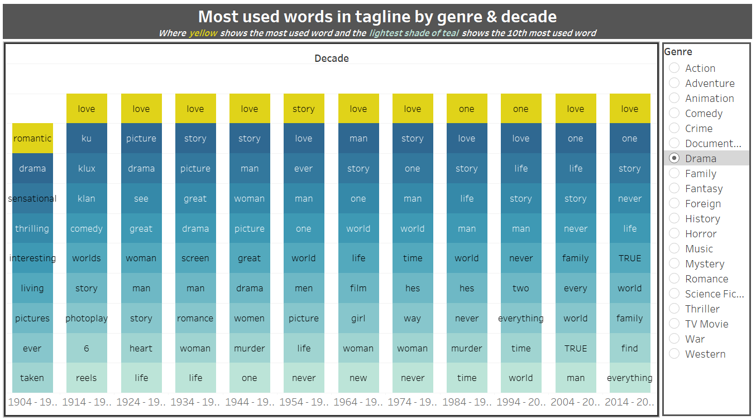
Question 5: Results - Genre & Decade (Drama)
The 1904-1914 theme suggests a mystery or crime narrative with elements of enduring love and personal relationships. It centers around a singular focus, potentially involving a dark plot with murder.
In contrast, the 2014-2017 theme revolves around the intertwining themes of love, family, and the search for authentic meaning in life. It emphasizes uniqueness, authenticity, and completeness, with a narrative structure that delves into familial relationships and the significance of personal quests.
Click here to explore

Slide 25
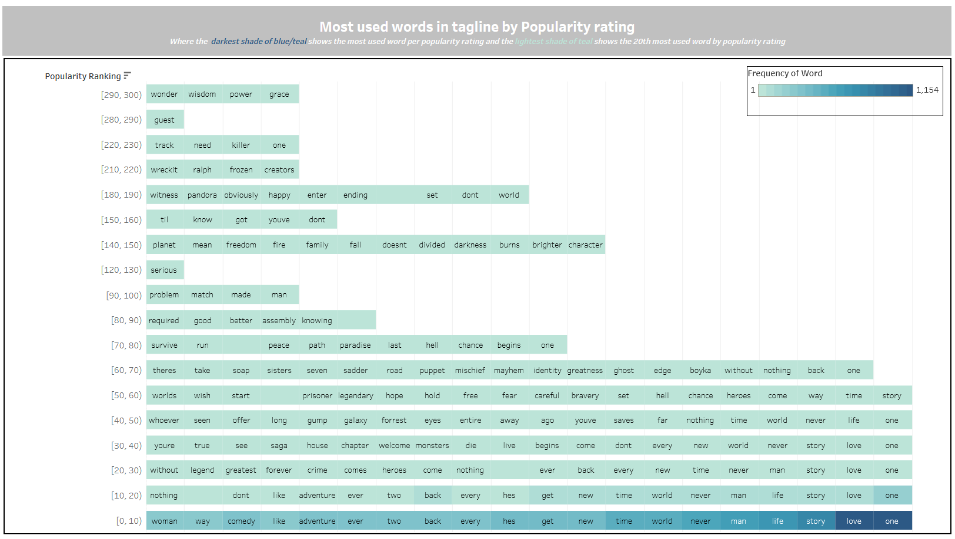
Question 5: Results - Popularity
Clear that when movies get past the 10 rating, there are less movies to pick from (which is why there are less words available). Seems like most of the movies fall within the 0-10 popularity ranking.
No sign of woman/women/girl within these top words.
No clear pattern.

Slide 26
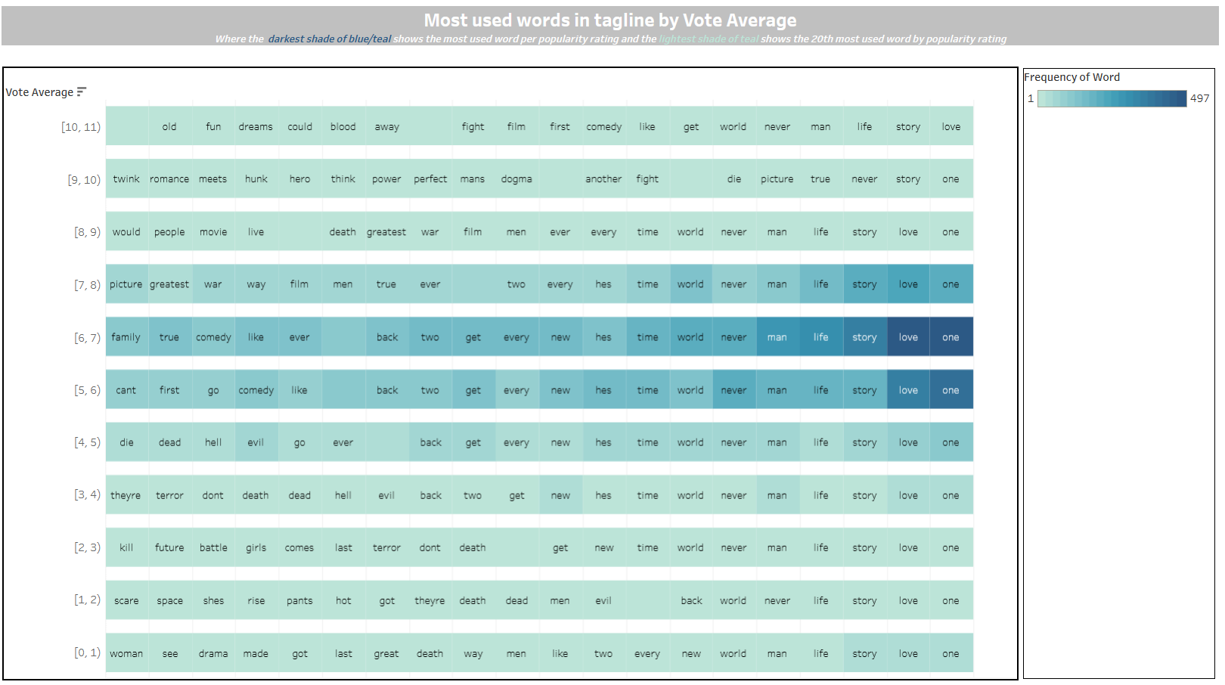
Question 5: Results - Rating
“love” seems to show up across the board. Seems like romance movies have the most standard deviation in rating.
No showcase of women/woman/girl at all within the top 10 words.
No clear pattern but could be of use to directors/filmmakers when creating taglines.
Most movies receive a rating anywhere between 5-7 as it has the most amount of data.

Slide 27
Conclusion

Slide 28
Overall Takeaways
Question 1
Were able to get the multiple linear regression models for finding both popularity and rating. The rating MLR had a better R² score over 90.
Were also able to identify correlations between different columns. Vote count and revenue had high correlation in both models.
Question 2
Were able to identify timeless genres such as drama and comedy.
Popularity is more representative of present day mood than ratings.
More “serious” genres tends to perform better in ratings, possibly due to ratings measuring how well movies are made and do not take general interest into account while popularity does.
Question 3
It was possible to determine the top ten languages used in the film industry based on revenue.
Sought out the most popular genres for those languages.
Question 4
Despite a decline in the severity of male dominance within the industry, nearly every angle indicates that the Movie industry has not improved for women over time.
Ratings + Popularity are impacted by the Male to Female ratio.
Question 5
Some of the more timeless genres have had a change in theme but still remain the top rated which speaks to the power of genre
Genres like Western have deviated from its traditional form over time.
Romance is the only genre to include “woman/ women/girl” over time.
Allows directors to understand what words to include in taglines for better popularity + ranking.
Completed by: Margaret
Completed by: Nyi
Completed by: Alka
Completed by: Kiran
Completed by: Kiran

Slide 29
Further research/limitations
The count of movies per decade/year was not consistent which could have altered the results
Ratings and popularity scores are from various points in time. This dilutes the opinions on older movies/genres with opinions from the “future”.
Identifying additional factors that are more representative of a movie’s success at the time of release. However, impossible to completely separate past from the future.
When it comes to equality in casting, it is important to also look at pronouns that are gender neutral. Ultimately this is something that we did not get to address.
Notes:
Alka

Slide 30
Thank you!

